Slide 1
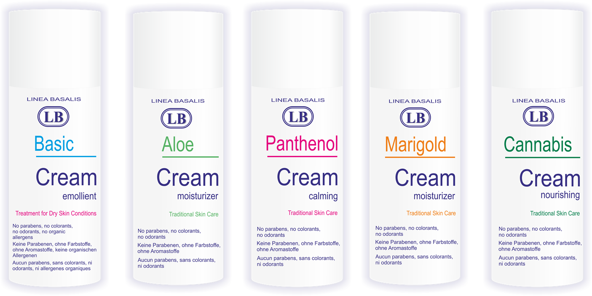
Linea Basalis therapeutic skincare

Slide 2
LB therapeutic skincare
Developed under the most rigorous standards by pharmacy scientists in collaboration with University hospital consultant dermatologists
Tried and tested by dermatologists and commonly used in the largest University hospital of Baltic states, in cases of skin diseases including children and infant ward, Burns centre ward*
Made with carefully selected, proven at efficacious levels and finest quality natural (vegetable) oils, herbal extracts, vitamins and antioxidants
No parabens and no colorants included in formula of any product
Small batch production airless and metal free packaging with dispensing systems allows customer to receive the best quality and safe product
No animal tests were carried out in relation to the development or effect for the skin evaluation of LB cosmetic products
*LB Clinic

Slide 3
LB features
LB line | Organoleptic properties | Parabens | Possible organic allergens | Colorants | Natural active plant ingredients
LB Clinic | Easy to apply | No | No | No | -
LB Aloe | Easy to apply, quickly absorbs to the skin | No | No | No | Vitamin E Aloe Vera juice Castor oil
LB Lavanda | Easy to apply | No | (Lavender and Grapefruit seed oil) | No | Vitamin E Olive oil
LB Calendula | Easy to apply, quickly absorbs and does not leave film on the skin surface | No | No | No | Marigold extract Vitamin E Olive oil Aloe Vera juice
LB Olive | Easy to apply | No | No | No | Olive oil Vitamin E
LB Panthenol | Easy to apply, quickly absorbs and does not leave film on the skin surface | No | No | No | Provitamin B5 (D- phantenol) Olive oil Aloe Vera juice
LB Cannabis | Easy to apply | No | (Peppermint essential oil) | No | Cannabis oil Vitamin E
LB Cananga | Easy to apply, quickly absorbs and does not leave film on the skin surface | No | (Ylang-Ylang essential oil) | No | Vitamin E Olive oil Aloe Vera juice Ylang ylang oil
LB Sea gel | Easy to apply, quickly absorbs and does not leave film on the skin surface | No | No | No | Dead sea salt

Slide 4
Our range
LB Clinic
Reliable formula for whole family. The emollient is designed to soften and hydrate the skin
All body skin care
LB Olive
Designed to soften, nourish and hydrate the skin
Suitable for sensitive and allergic skin
LB Aloe
Containing Aloe Vera Juice, helps the water to penetrate into the deepest layers of the skin, natural plant oils improve the skin elasticity.
Suitable for body and face skin care.
Suitable for sensitive and allergic skin
All body skin care, especially hand and feet skin care

Slide 5
Position, range, price
Pioneering therapeutic cosmetic skincare
Strong competitor to leading brands like E45 and Oilatum
Added finest quality natural active ingredients sets it apart from similar products in market
Innovative, customer oriented choice in ever growing healthy choices market
No parabens
No colorants
No animal testing
LB Line | SKUs | Ex works price, EUR
LB Clinic
LB Aloe
LB Lavanda
LB Calendula
LB Olive
LB Panthenol
LB Cannabis
LB Cananga
LB Sea gel

Slide 6
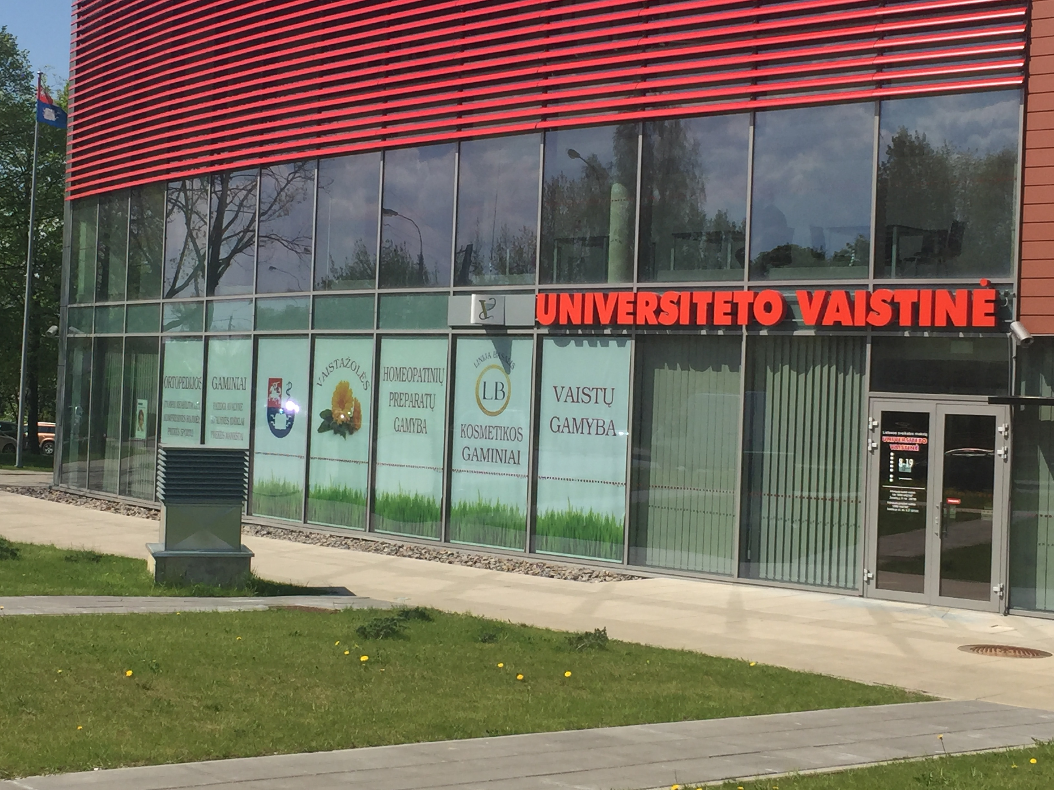
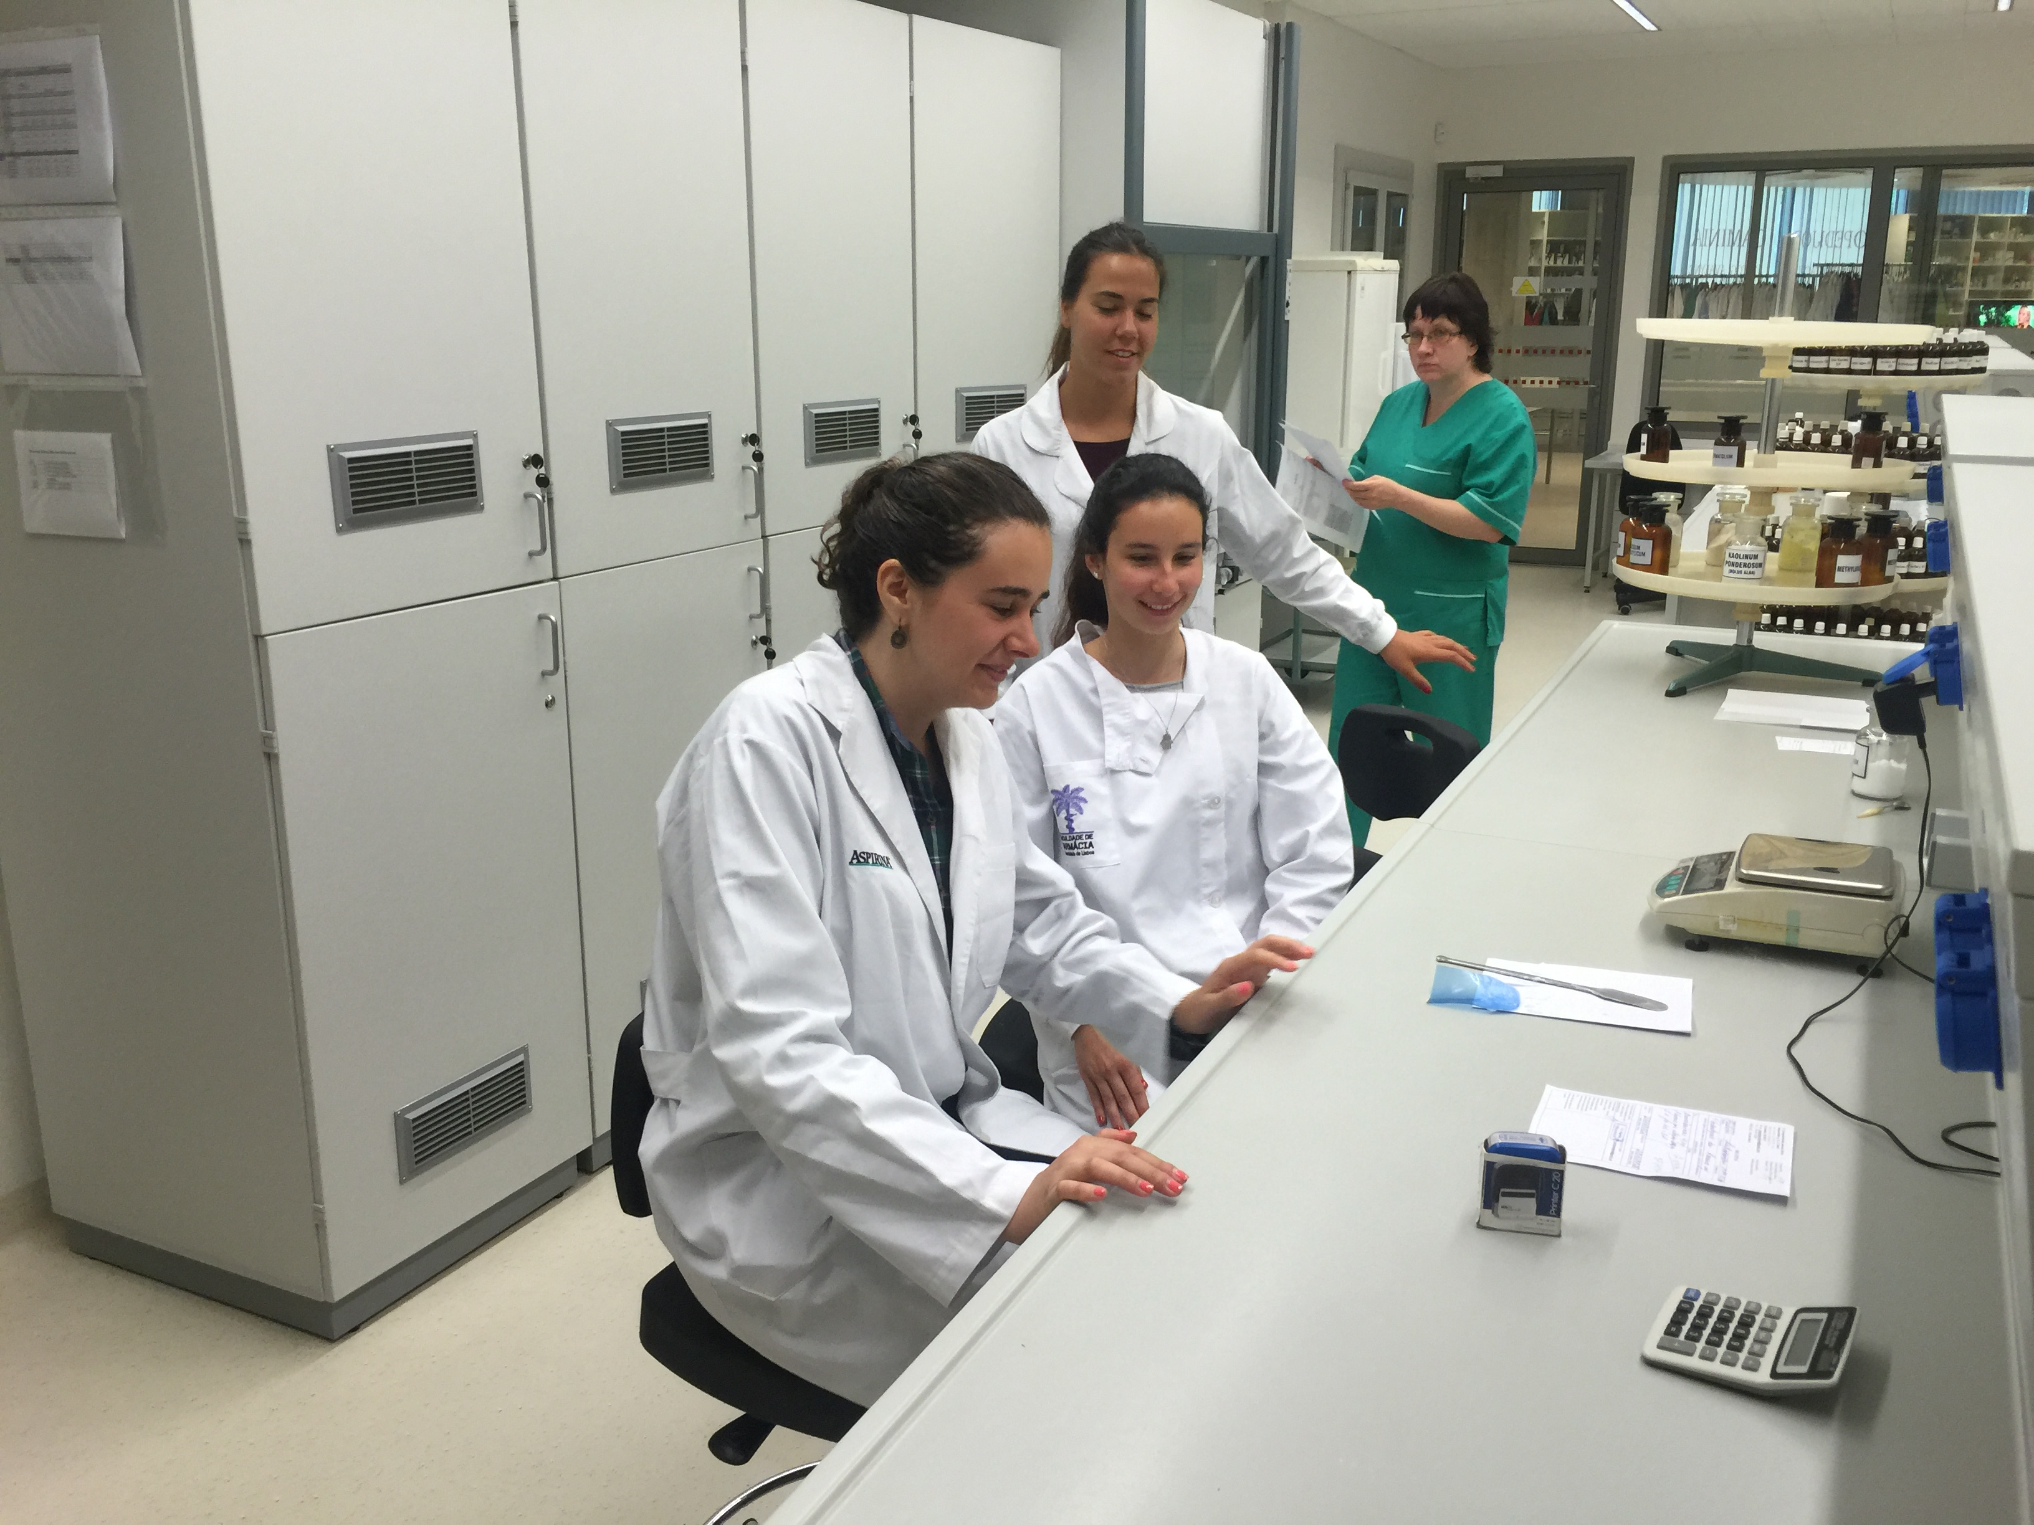
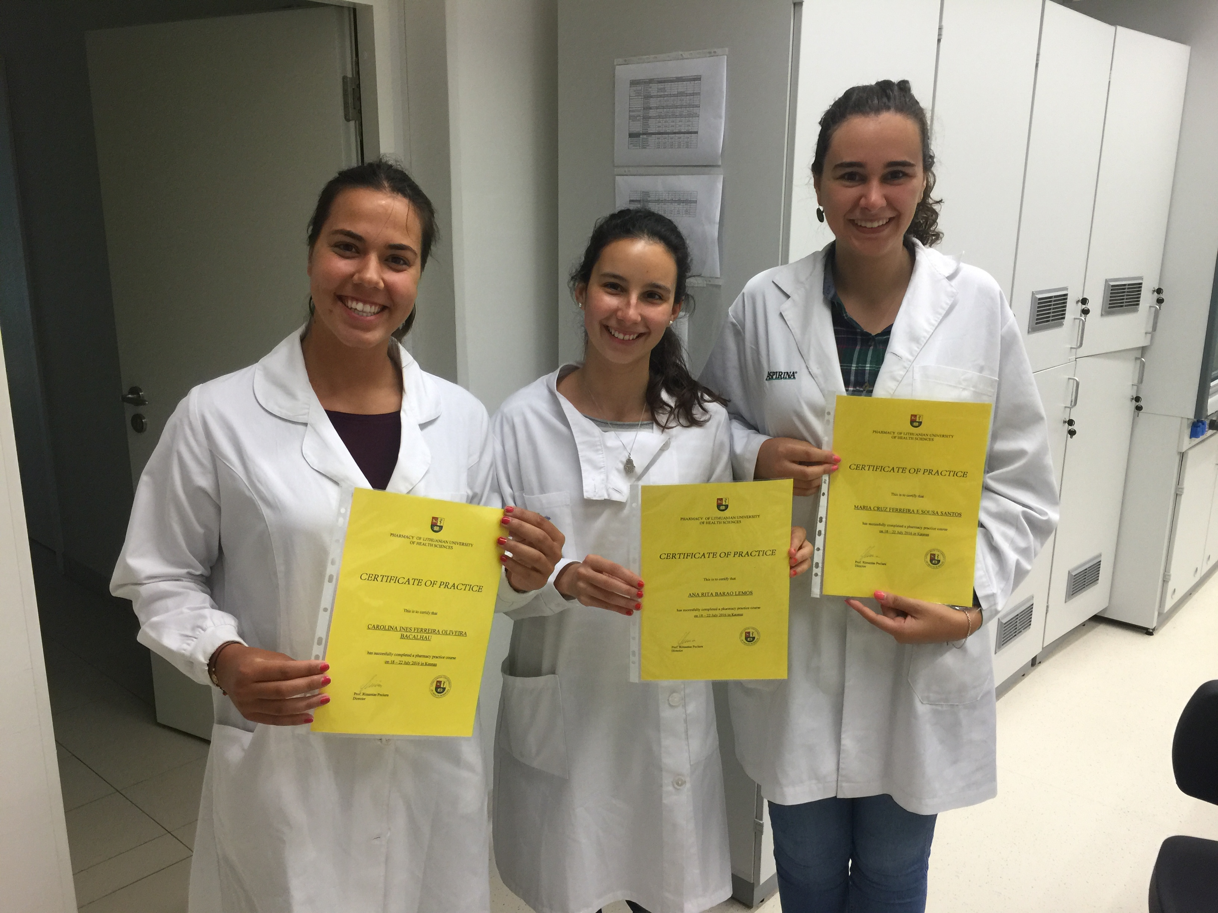
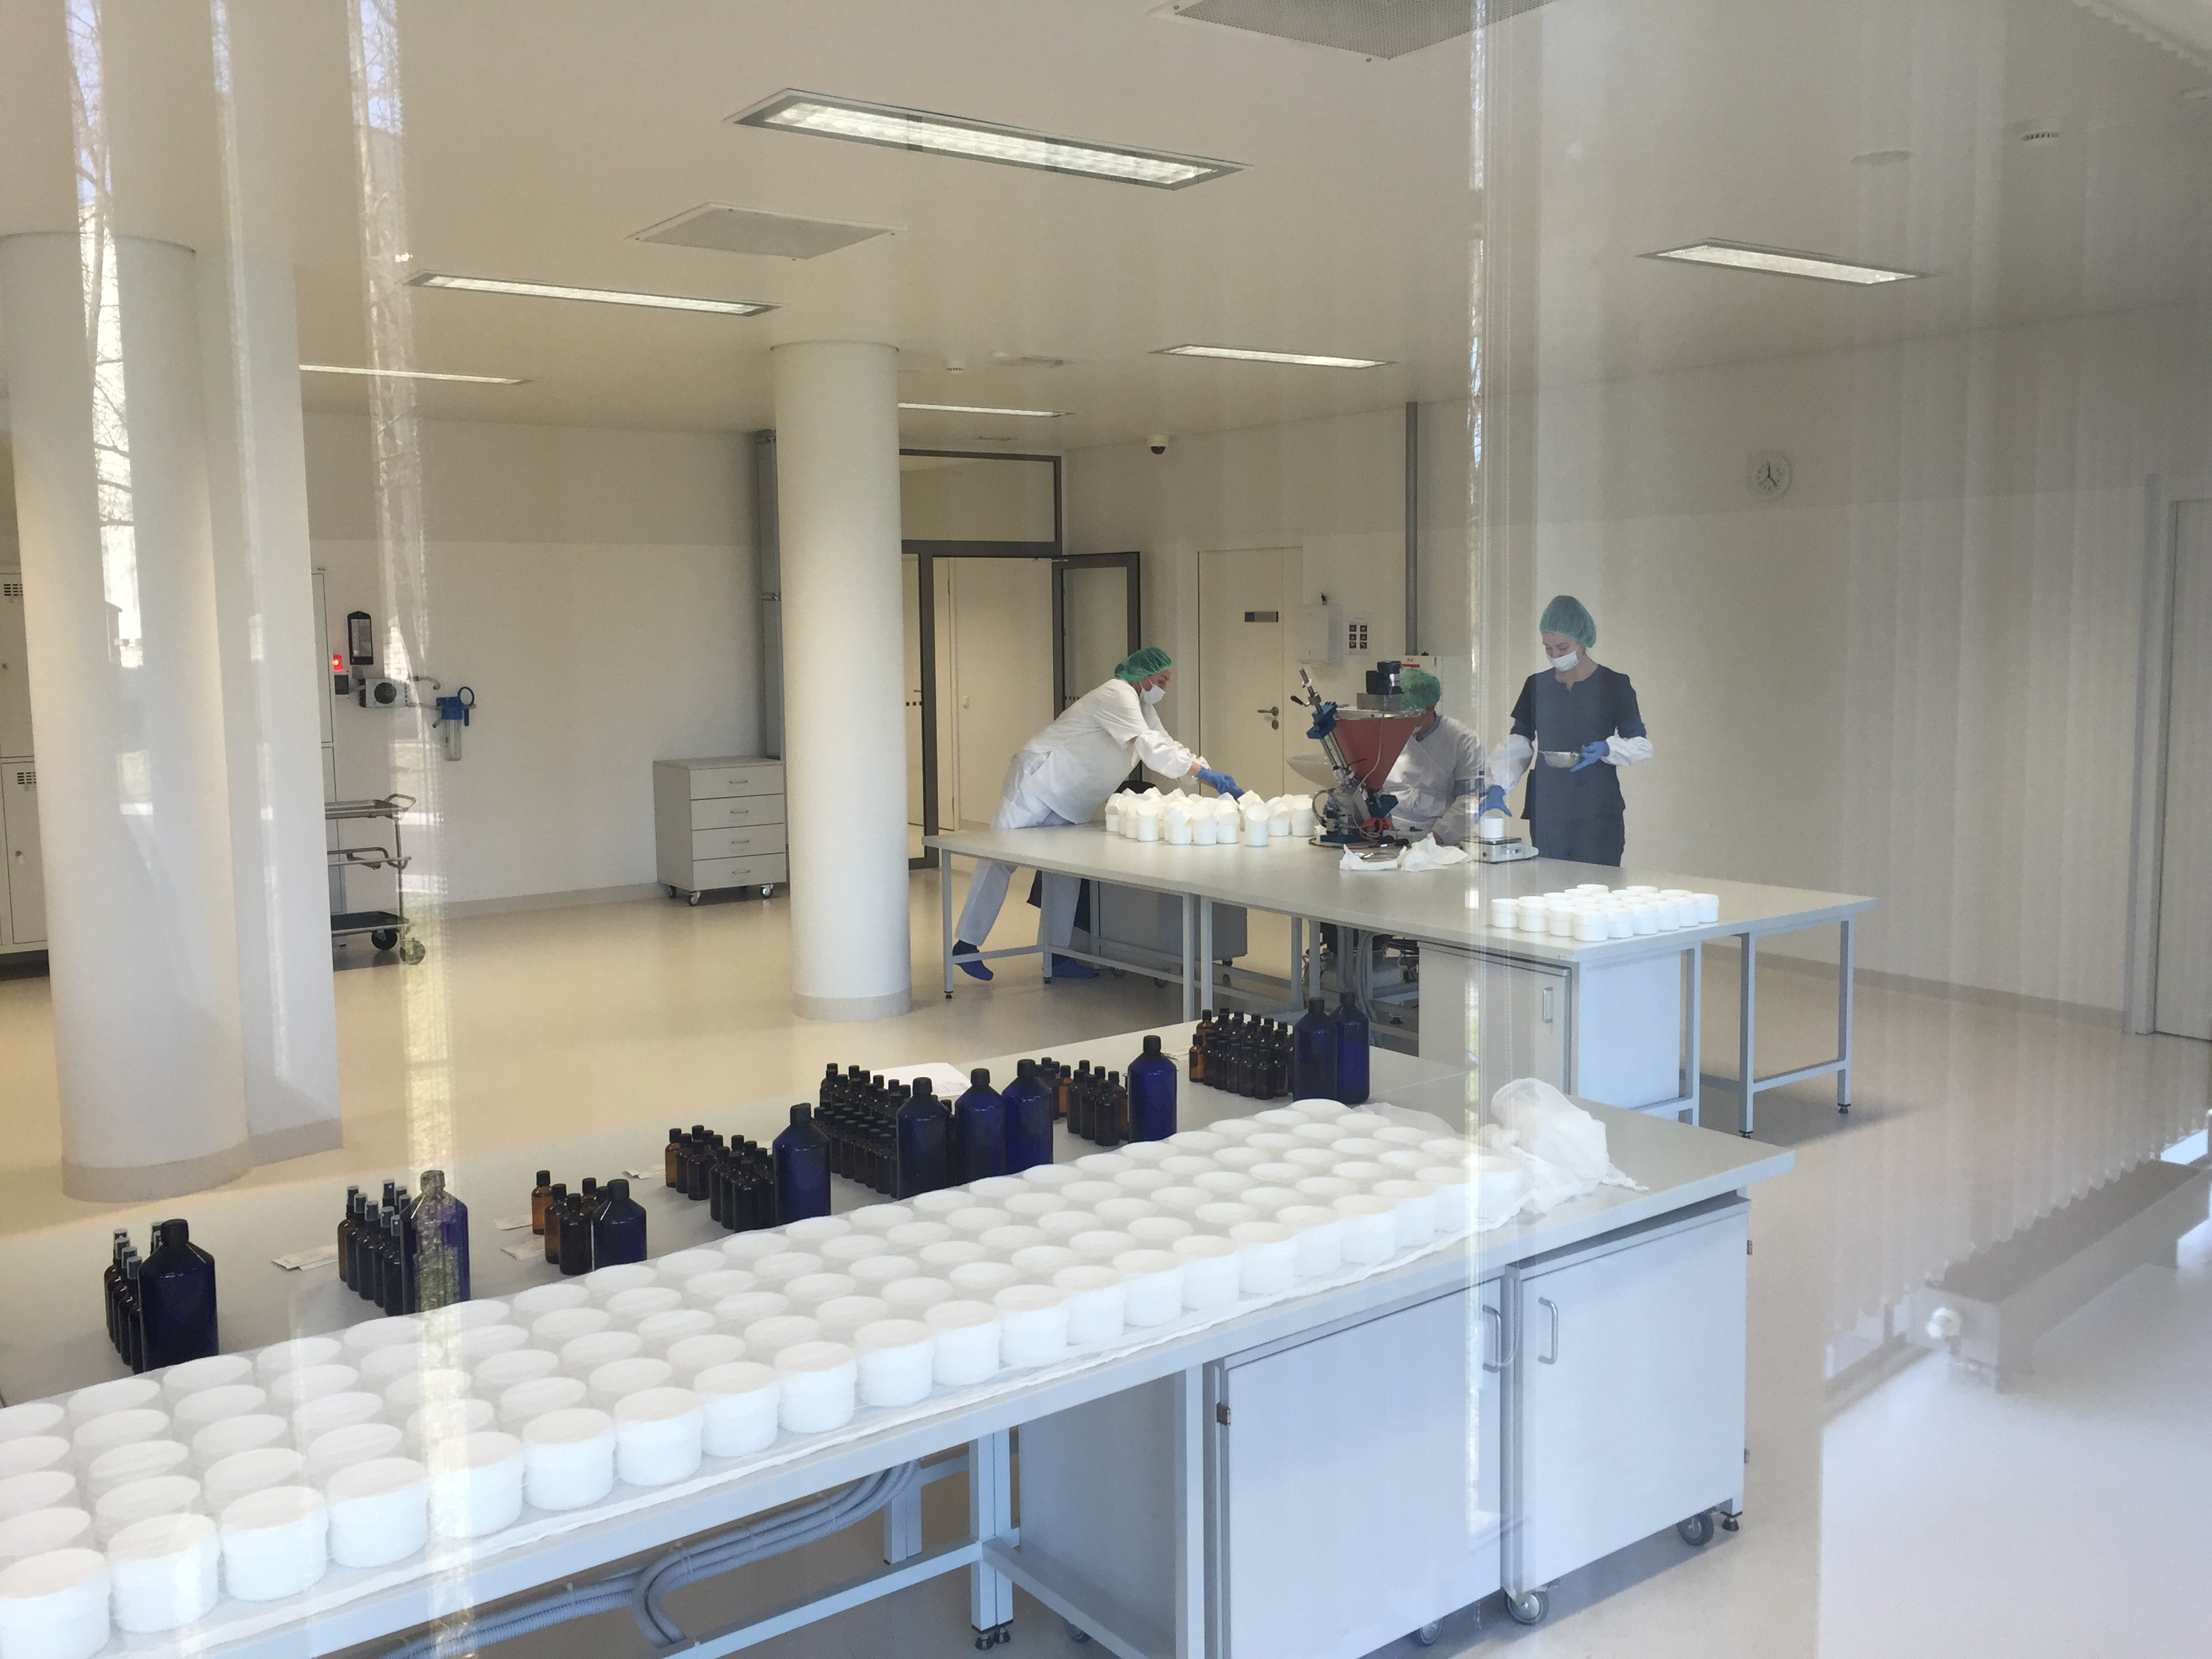
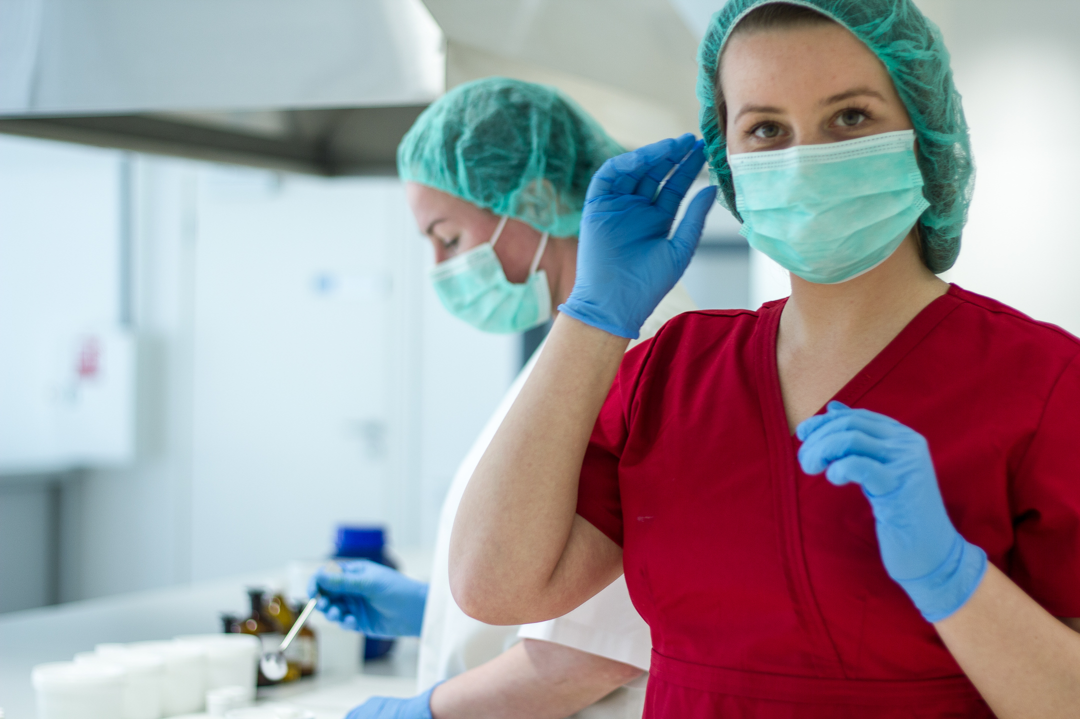
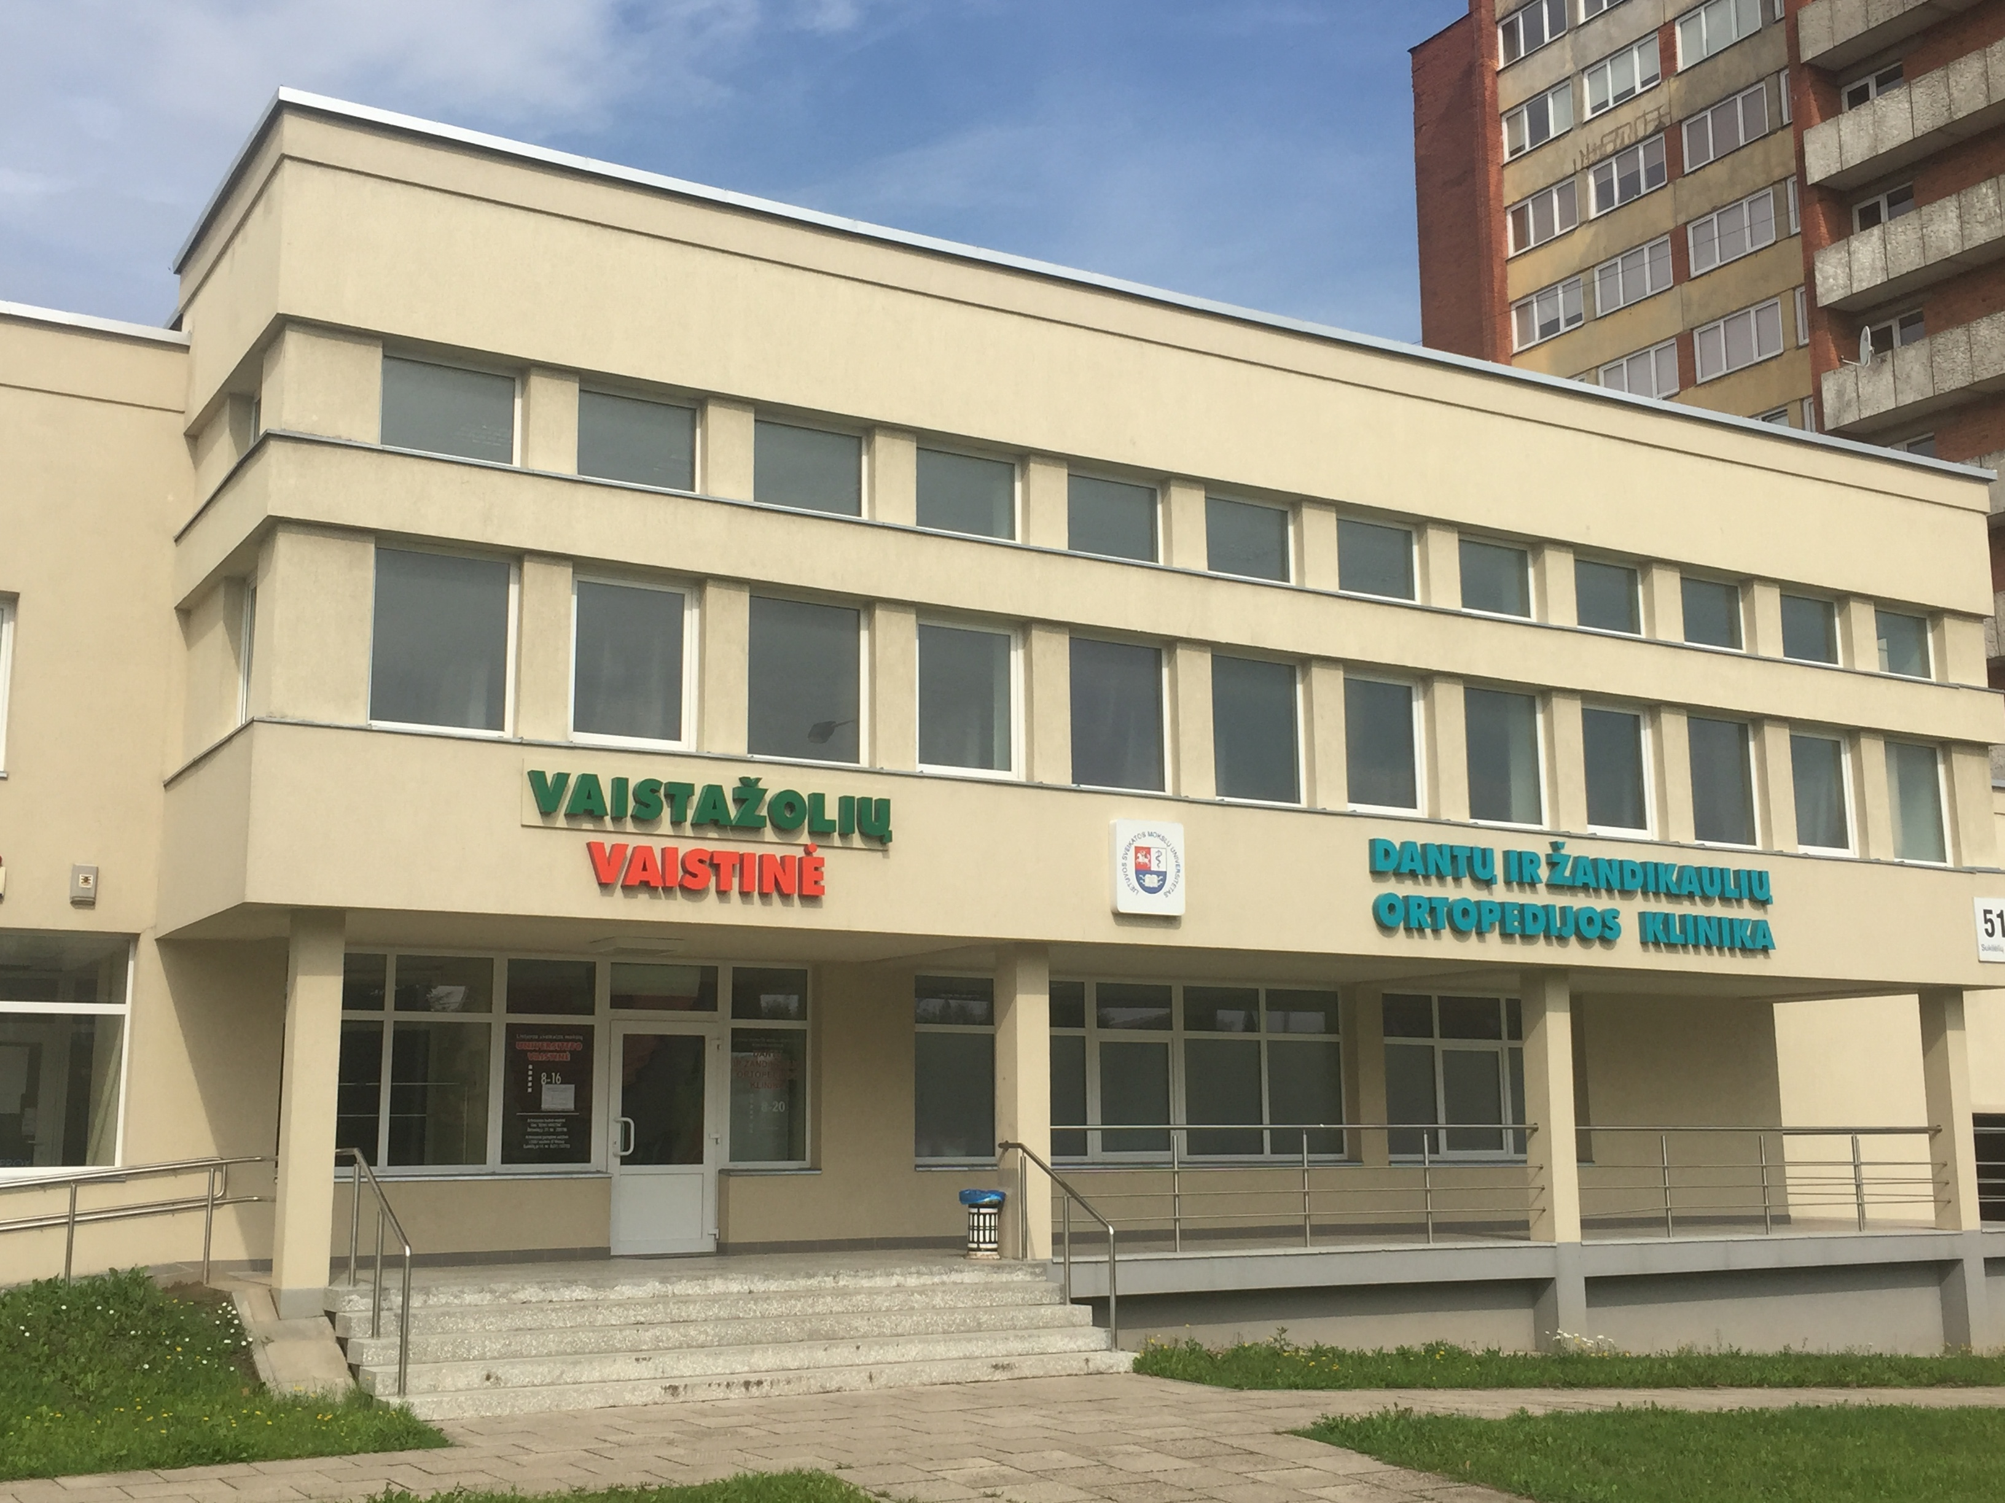
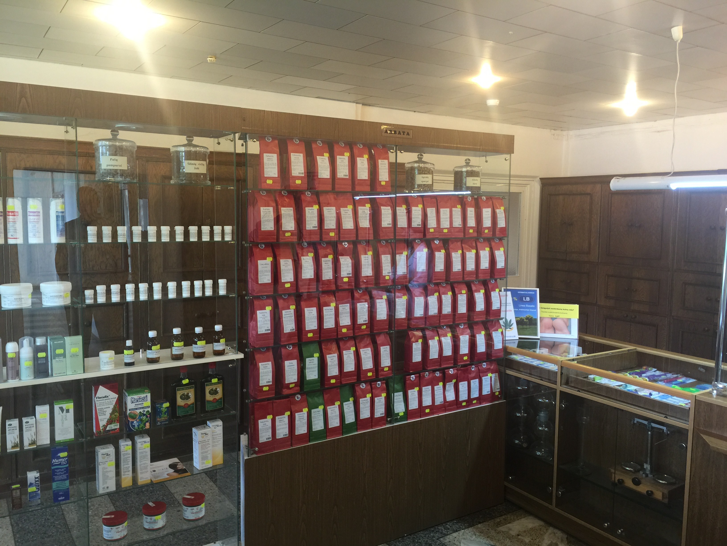
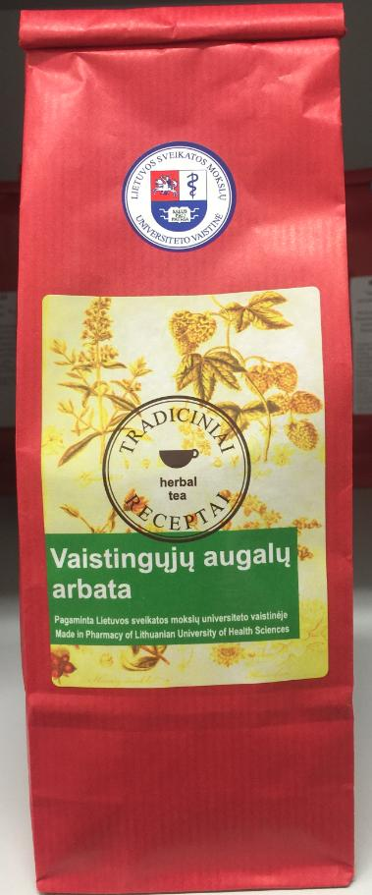
About us
PHARMACY OF LITHUANIAN UNIVERSITY OF HEALTH SCIENCES
science and practice...
Fifth-year pharmacy students from our university develop their first practical skills in his own pharmacy. Also foreign students from all around the world every year arrive to practice here.
Pharmacy runs industrial production line of emollients, cosmetics under international requirements of Good Manufacturing Practice. The products are notified in the European Union and are distributed in Lithuania and foreign market.
Very special our production is Herbal Tea line. The formula of these products are most traditional, the new ones are designed by our farmacists and scientists of university.

